Slide 1


Recording, Analyzing and Using Physiological Signals in Psychology
Dominique Makowski
D.Makowski@sussex.ac.uk
04/2024 Workshop at

Slide 2
Plan
Introductions
Goals
Plan for today
Theory
Practice
Flexibility
Slides: https://github.com/DominiqueMakowski/teaching
Contact: D.Makowski@sussex.ac.uk

Slide 3
Body & Mind

Slide 4
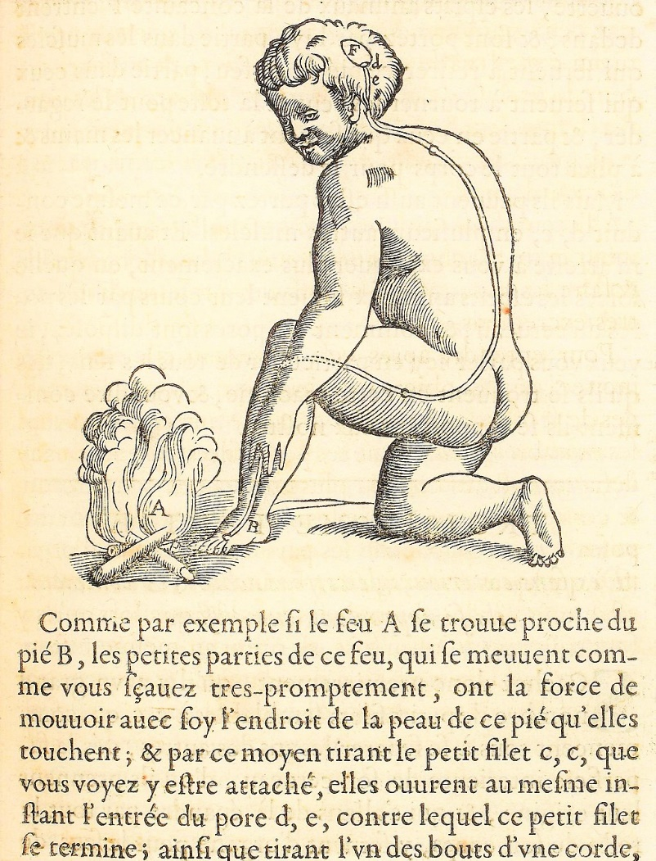
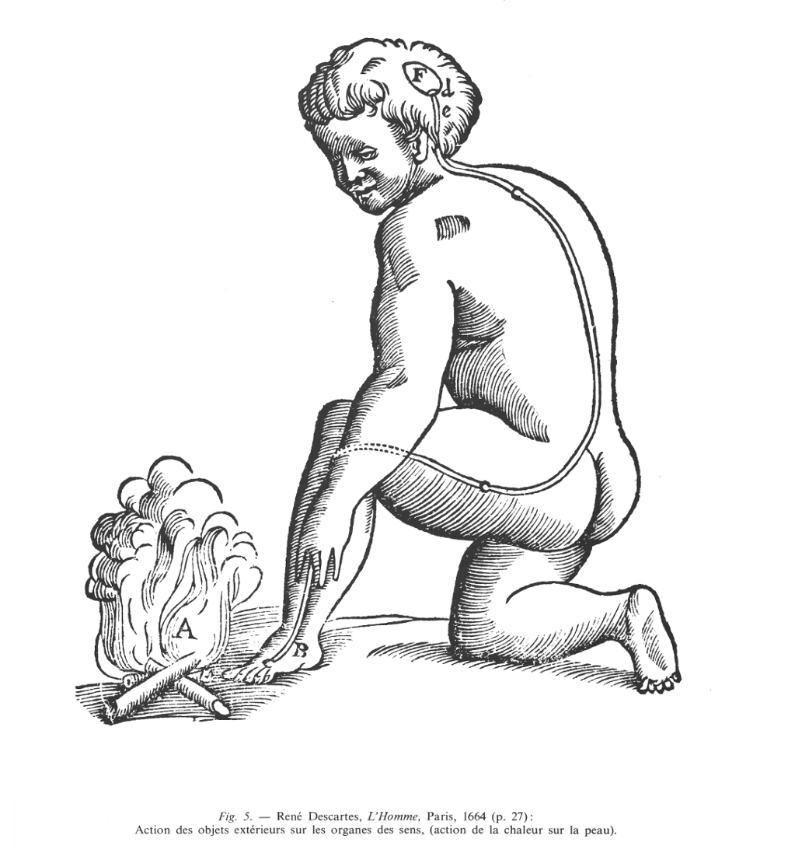
Ghost in the Machine
What is the relationship between the body and the mind?
Long philosophical tradition of “dualism” (e.g., Platonism, monotheisms)
In philosophy of mind, “Mind-body Dualism” denotes the view that the mind and body are distinct and separable, and/or that mental phenomena are non-physical
The “ghost in the machine” (Ryle, 1949) is a term originally used to describe and critique the concept of the mind existing alongside and separate from the body
If they are two different things: how does the mind control the body?
Descartes (1664) in « L'Homme » Treatise on Man
Body and mind are two fundamentally different “substances”
They interface at a special organ: the pineal gland
Body enables the mind to make actions (they do still interact)
Notes:
substance pensante (res cogitans) et la substance étendue (res extensa)
animal spirits
« Comme par exemple si le feu A se trouve proche du pied B, les petites parties de ce feu, qui se meuvent comme vous savez très promptement, ont la force de mouvoir avec soi l'endroit de la peau de ce pied qu'elles touchent ; et par ce moyen tirant le petit filet c, c, que vous voyez y être attaché, elles ouvrent au même instant, l'entrée du pore d, e, contre lequel ce petit filet se termine ; ainsi que tirant l'un des bouts d'une corde, on fait sonner en même temps la cloche qui pend à l'autre bout. Or l'entrée du pore ou petit conduit d, e, étant ainsi ouverte, les esprits animaux de la concavité F (glande pinéale) entrent dedans et sont portés par lui partie dans les muscles qui servent à retirer ce pied de ce feu, partie dans ceux qui servent à tourner les yeux et la tête pour le regarder, et partie en ceux qui servent à avancer les mains et à plier tout le corps pour le défendre. Mais ils peuvent aussi être portés par ce même conduit d, e, en plusieurs autres muscles. » (Descartes, l’Homme, 1664, p. 27)

Slide 5
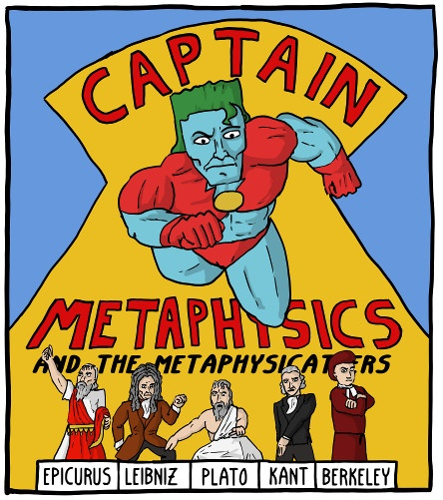
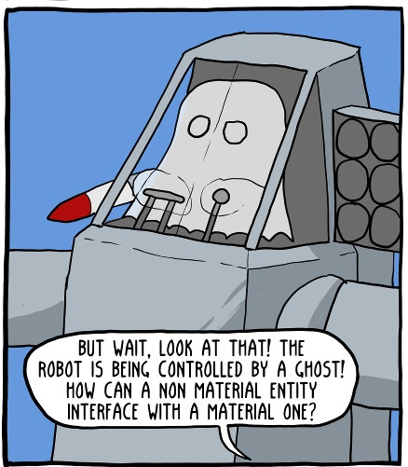
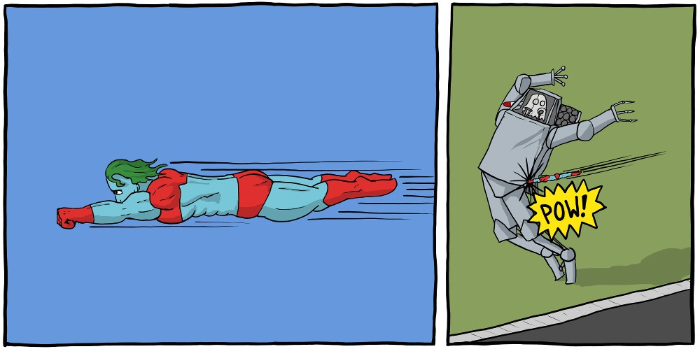
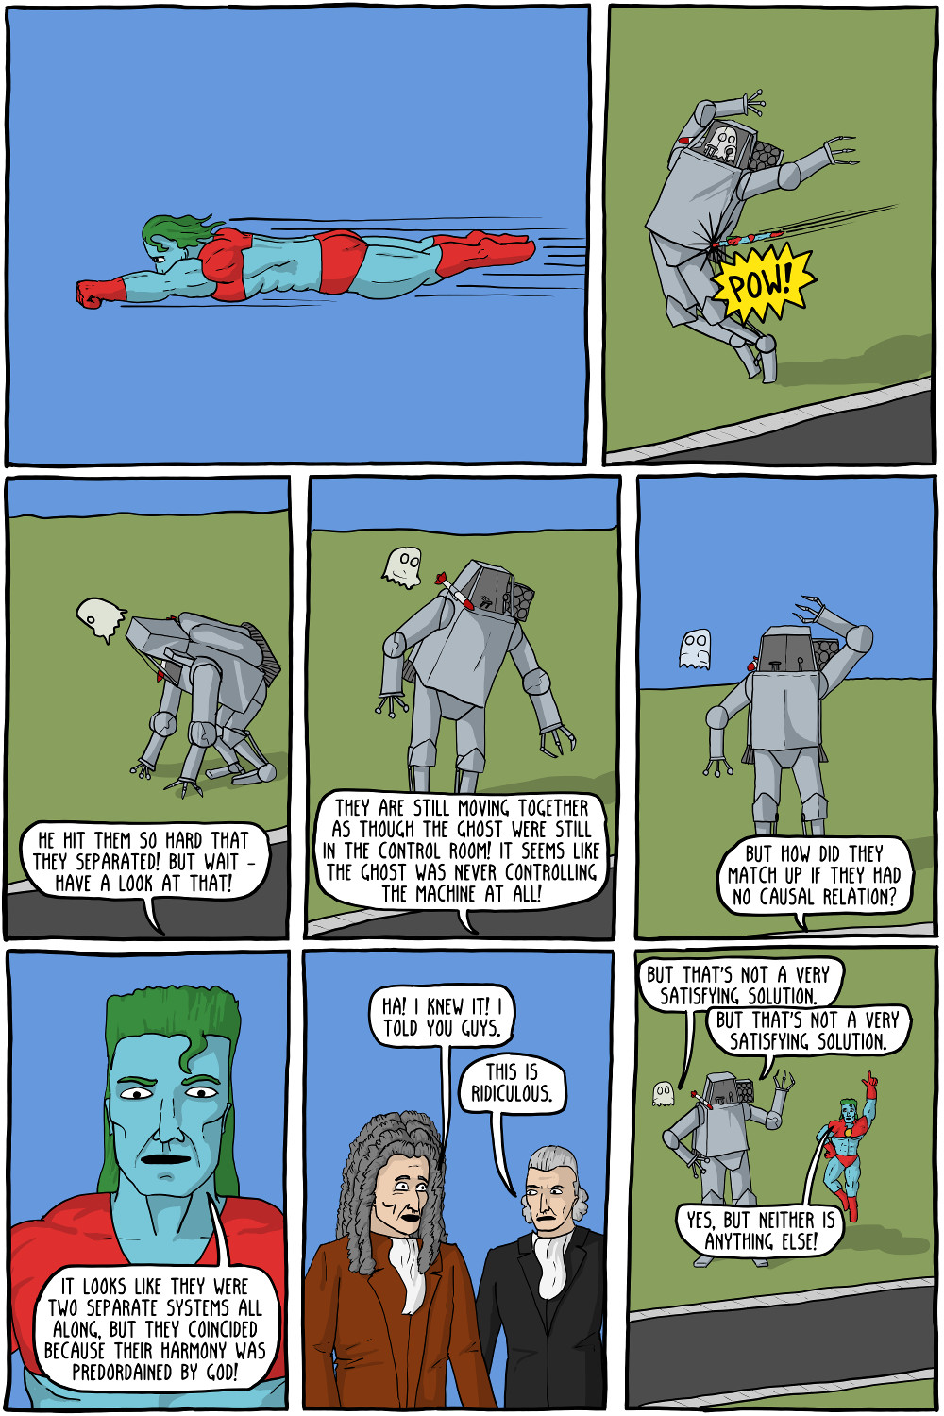
Ghost in the Machine
Leibniz (1714) in « Monadologie »
Psychophysical parallelism: Mental and the physical phenomena do not interact but only coincide (because God set it up that way)
“Pre-established harmony”
https://existentialcomics.com/comic/47

Slide 6
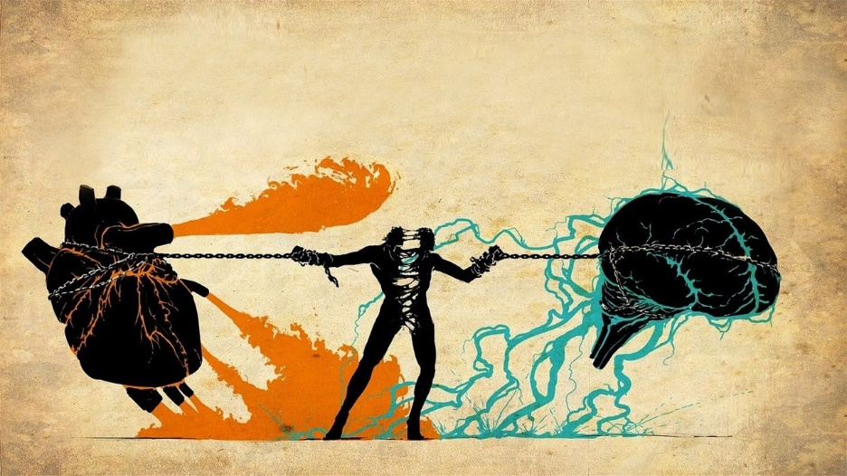
Dualism in the 21st Century
What is the current situation?
Mind–body dualism still has strong echoes in certain domains
E.g., consciousness science: in the existing debate about the relationship between neural processes and conscious experience (the “hard problem of consciousness”; Chalmers, 1995)
Current situation
In cognitive neuroscience & psychology, overall agreement over the fundamental role of bodily processes in shaping cognition
Future comeback?
Reemergence of dualism with views imported from the social sciences (e.g., identity is a fundamentally social construct orthogonal to biological determinants)
AI systems? Advanced cognition without biological bodies?

Slide 7
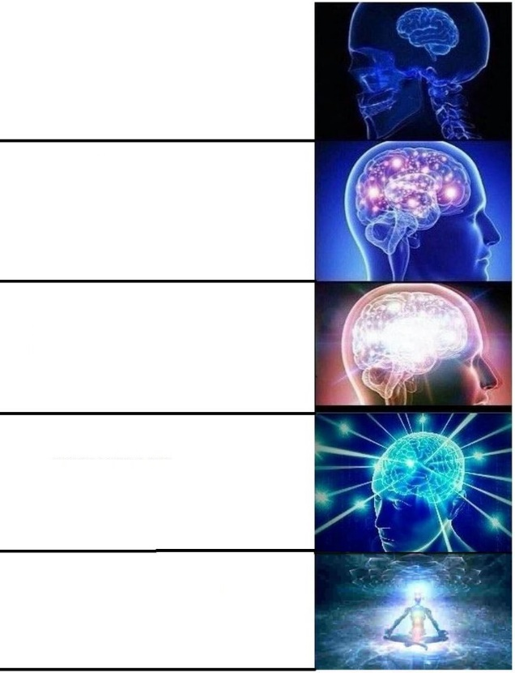
Psycho + Physio?
Embodied cognition: Cognition is shaped by physiological states and capabilities of the organism
Evidence suggests that the fabric of our reality, our conscious experience and sense of Self is embodied
Research interest in the process of embodiment itself (e.g., through interoception, i.e., the way the mind senses and represents its own physiological state)
Psychophysiology: the study of the relationship between physiological and psychological phenomena (i.e., the way in which the mind and body interact)
Study at school
Learn psychology at uni
Get interested in the role of the body in mental processes
See that there is no distinction between your body and your mind
Accept that there is no you but only the one

Slide 8
Interoception

Slide 9


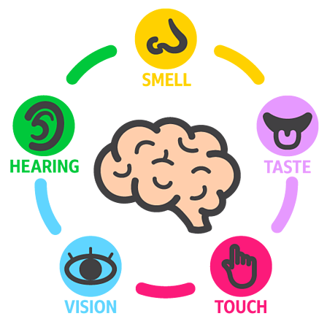
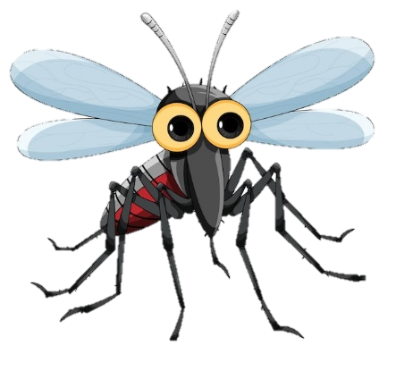


The 5 senses… make little sense
Conscious Experience
« What it’s like to be a bat? » (Nagel, 1974)
Exteroception
Interoception
Taste
Smell
Hearing
Vision
Touch
Body Awareness
Proprioception: Sense of the relative position of one's own body parts
Equilibrioception: Sense of balance and movement (vestibular system)
Interoception
Thermoception: The ability to sense temperature and its changes
Sweat glands (electrodermal activity / skin conductance)
Nociception: Perception of pain
Humoception: Humoral receptors are sensitive to hormones
Visceroception (Interoception)
Bladder
Stomach (hunger, thirst)
Lungs (respiration)
Cardiovascular system (heart)
Sensing of physiological states and changes
Non-human (?)
Magnetoception: sensitivity to magnetic fields
Chemoception - pheromones
Vision – Infrared, ultraviolet
…
Notes:
What about touch?

Slide 10
Interoception Definition
Role
Physiologically, interoceptive signaling is involved in coordinating homeostatic reflexes (e.g., control of blood pressure or glucose levels within a set range) and by guiding predictive (allostatic) autonomic and behavioural responses (e.g., preparing the body for action by increasing blood pressure and heart rate)
Psychologically, interoceptive representations are proposed to underpin both motivational (e.g., hunger) and emotional (e.g., anxiety) feeling states and play an important role in cognition and consciousness (minimal consciousness, sense of reality, …)
Definition
“Interoception is the body-to-brain axis of sensation concerning the state of the internal body and its visceral organs” (Sherrington, 1948)
“Interoception refers to the process by which the nervous system senses, interprets, and integrates signals originating from within the body, providing a moment-by-moment mapping of the body’s internal landscape across conscious and unconscious levels” (Khalsa et al., 2018)
Signaling, processing, representing, and integrating internal bodily states
🔥 Hot topic of research
Notes:
homeostasis = aspects of physiology that maintain life
allostasis = active process of maintaining/re-establishing homeostasis. Dysregulatory (or disordered) form of physiological regulation.

Slide 11
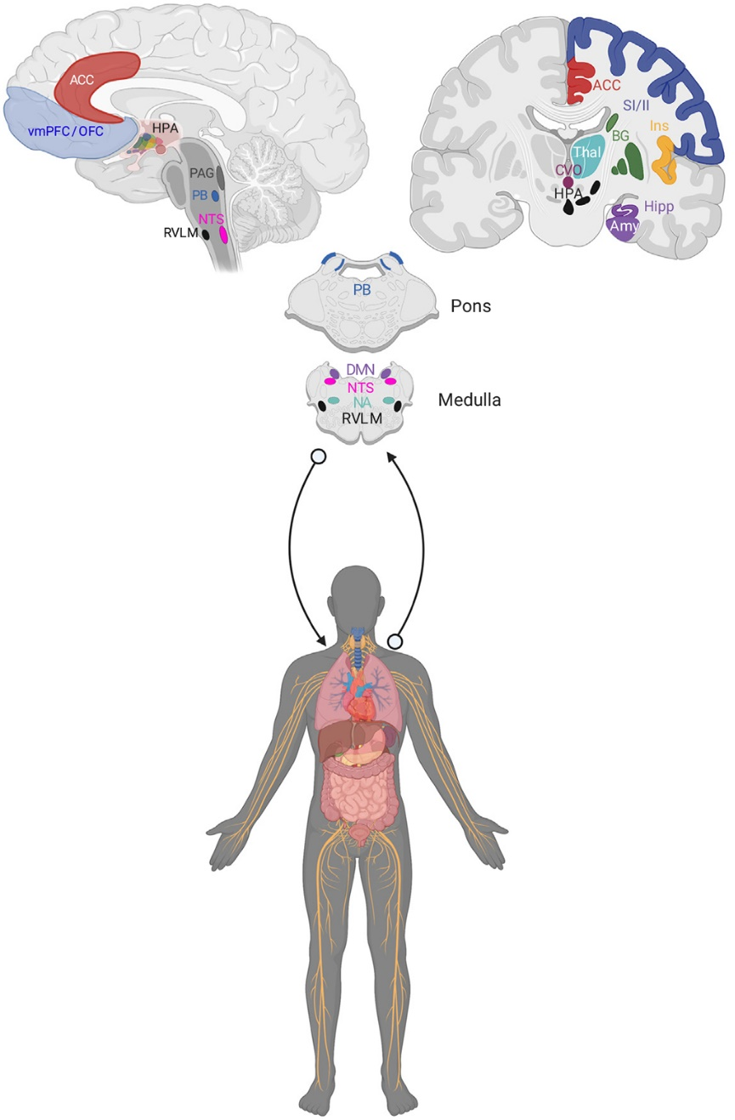
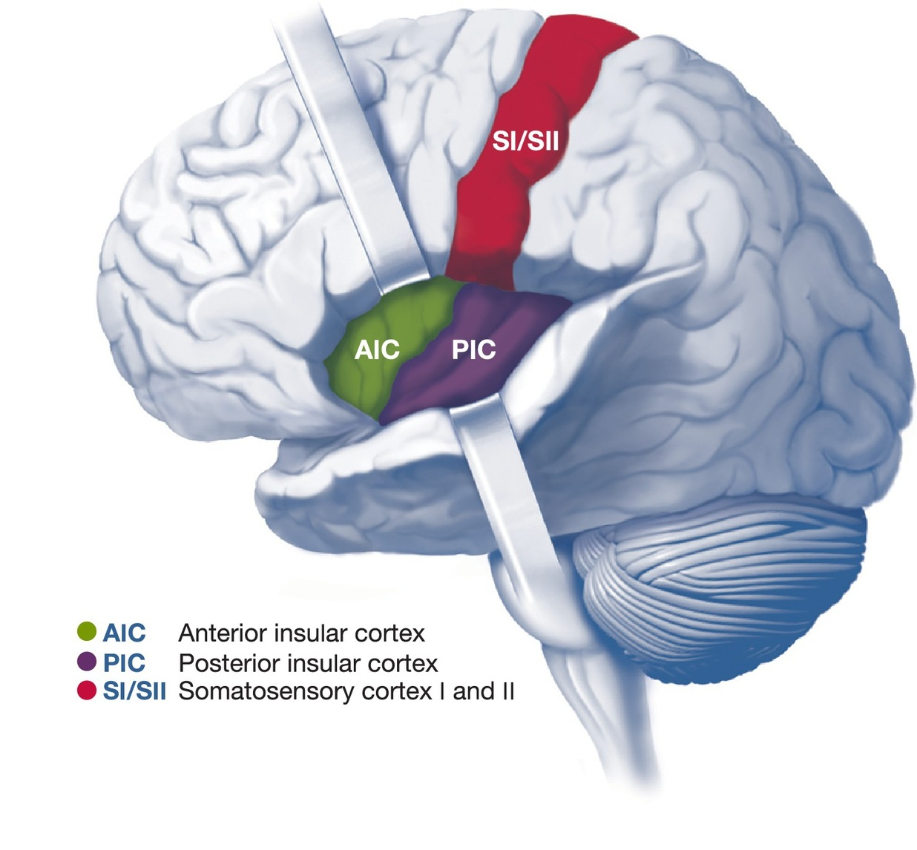
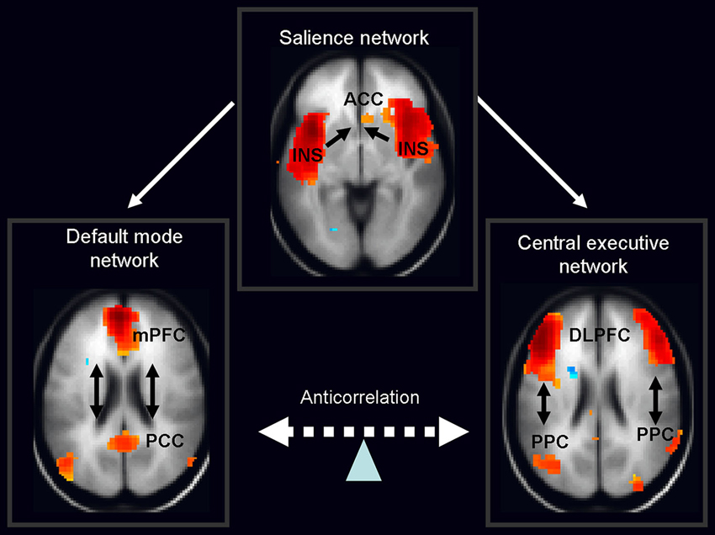
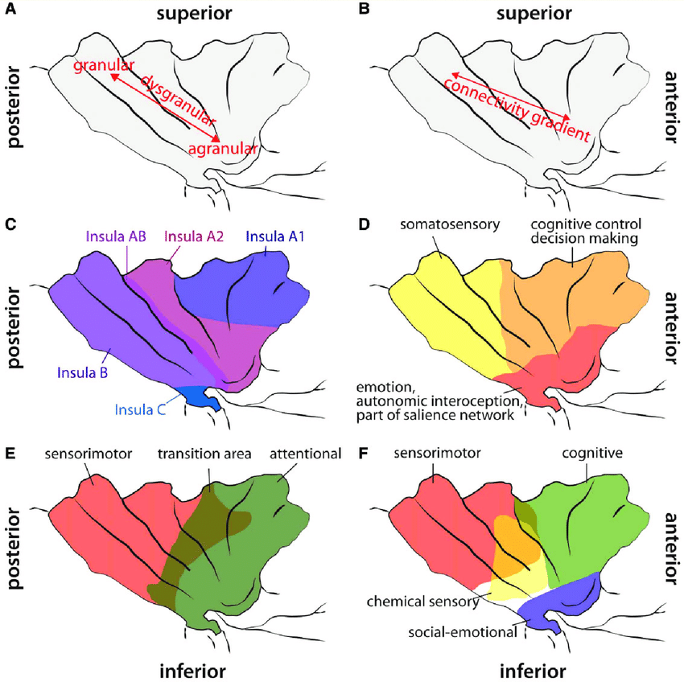
Neural Bases
Receptors (Mechanoreceptors, Chemoreceptors, Baroceptors, …)
The vagus nerve is a major afferent conduit for interoceptive signals (+ also carries parasympathetic efferents)
Subcortical (brain stem, thalamus)
Cortical
Posterior insular cortex (PIC)
Interoceptive information is related from the ventromedial nucleus of the thalamus to the posterior insula
Integration with exteroceptive sensorimotor and proprioceptive information most likely takes place within the posterior / central regions
Anterior insular cortex (AIC)
Strongly connected to orbitofrontal cortex (OFC) and the anterior cingulate cortex (ACC): may be involved in connections between interoceptive and emotional or cognitive states
Postero-anterior insular gradient
The insula is considered to be part of the salience network
Berntson (2021)

Slide 12

Multidimensional?
Does interoception refer to a single process?
Different levels of processing (unconscious sensing -> conscious and purposeful integration)
Partially distinct physiological pathways
Cardioception – the most studied
Respiroception
Gastroception
…
What about “external” interoception (perception of the body via external senses, e.g., odours from the body, looking at oneself, …)
BUT, information likely integrated at a higher level (?)
Is interoception a unified ability?
🤷
Research is needed, but challenging:
How to measure different facets of interoception?
Often requires specific equipment (e.g., psychophysiological signals recordings)

Slide 13
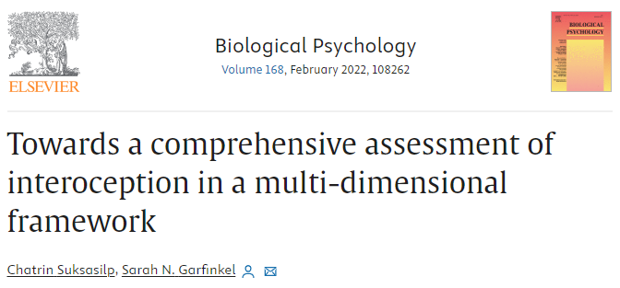
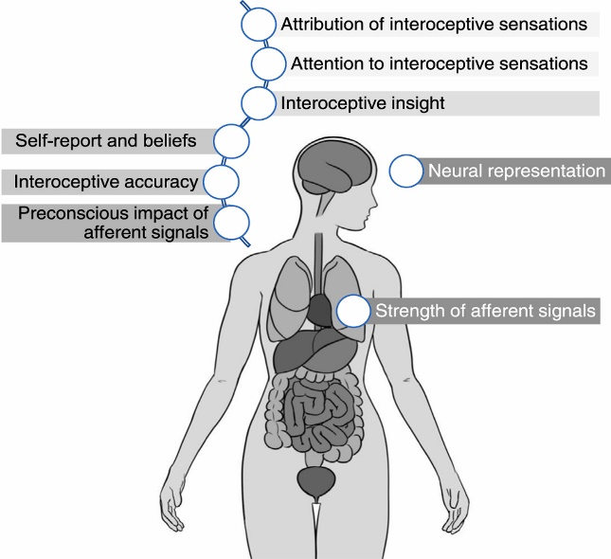
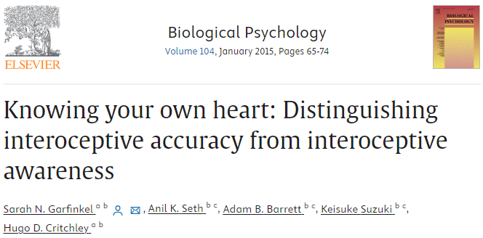
Dimensional models
Interoceptive Awareness
Metacognitive awareness of interoceptive accuracy
3 facets of interoception (Garfinkel et al., 2013, 2014)
Interoceptive Accuracy
Objective performance at interoception tasks
Interoceptive Sensibility
Subjective experience in interoception tasks
Interoceptive Awareness
Metacognitive aspect
Multidimensional model
(Suksasilp, 2022)
Signal strength
Neural representation
Attention orientation
Attribution processes
Beliefs
…
🔥 Active research area
Assessed via subjective awareness of objective accuracy (e.g., correlation between accuracy and sensibility scores)
Interoceptive Accuracy
Objective accuracy in detecting internal bodily sensations
Interoceptive Sensibility
Dispositional tendency to be internally focused; self-reported beliefs about body tendencies
Assessed via objective tests of interoceptive performance (e.g., heartbeat detection tasks)
Assessed via self-report measures (e.g., questionnaires, subjective confidence ratings)

Slide 14
Measuring Interoception
Direct
Capturing interoceptive processes
Indirect
Measuring the coupling between physiology and neurocognition
Objective
Signalling and processing aspects
Subjective
Conscious metacognitive interpretation
Ability level
Characteristics related to coupling
Mechanism level
Measures of
psychophysiological coupling
Implicit
Bypass conscious & metacognitive processes
Explicit
Ask participants to consciously attend interoceptive processes
Examples
of measures
EEG
Heartbeat Evoked Potentials (HEPs) and Fluctuations (HEFs)
Tasks
Heartbeat Counting Task
Heartbeat Tracking Task
Heartbeat Discrimination Task
…
Questionnaires
MAIA, IAS…
Self-reports
Scales of confidence / performance
Assessment of related traits
Emotional reactivity / regulation (?)
Alexithymia (?)
Mindfulness (?)
…
Physiological indices
Heart Rate Variability (HRV)
Effect of cardiac phase
…

Slide 15
Interoceptive Paradigms
Questionnaires
MAIA
IAS
Cardioception
Heatbeat Tracking (Schandry, 1981)
Low reliability
Sensitivity to changes in rate of heartbeats as a measure of interoceptive ability (Larsson et al., preprint)

Slide 16
Quizz
True / False?
Descartes located the centre of consciousness in the insula
Thanks to science, body-mind dualism is a thing of the past
The Insula is a brain region devoted to « disgust » as one of the 5 basic emotions
The posterior insula is the most tightly connected region with prefrontal cortex
Interoception is a multidimensional construct
There is only one proper way of measuring interoception
Subjective measures (e.g., questionnaires) of interoception are by definition invalid

Slide 17
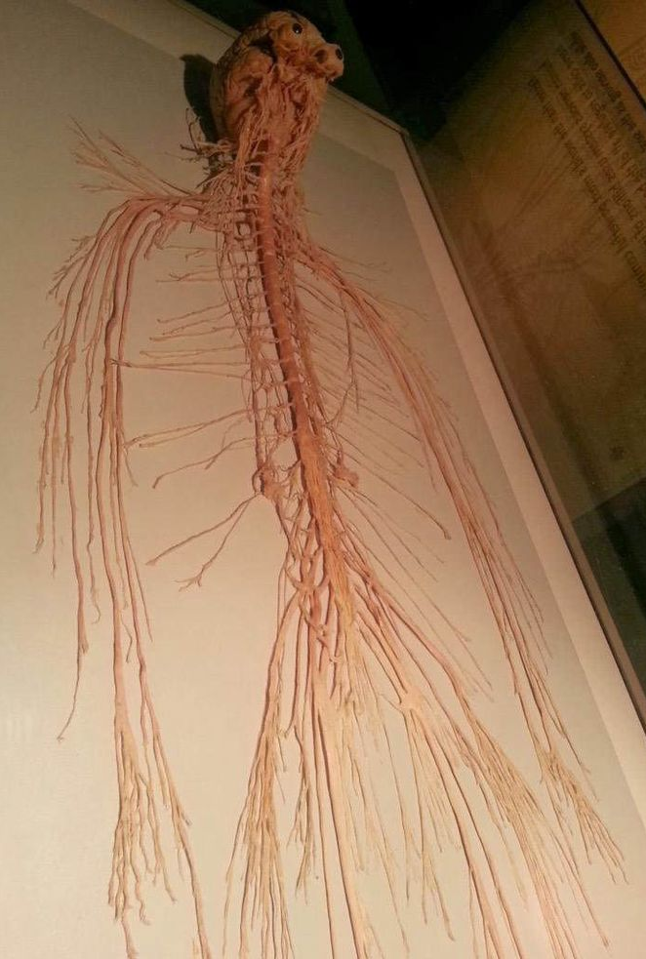
Neuroanatomy Below the brain
This is literally me

Slide 18
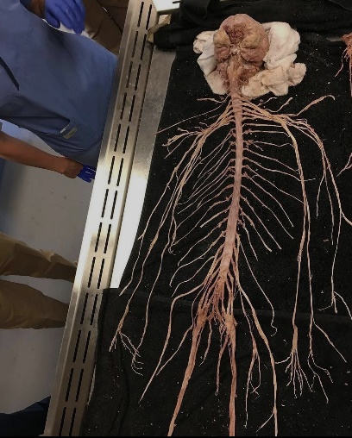
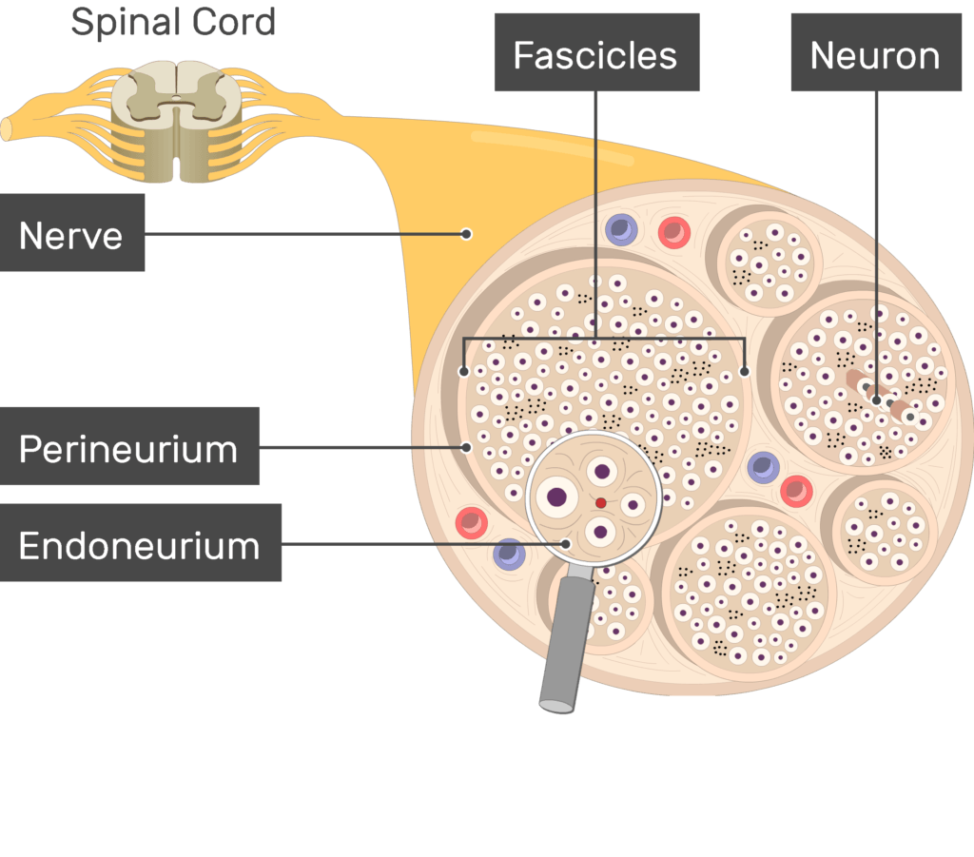
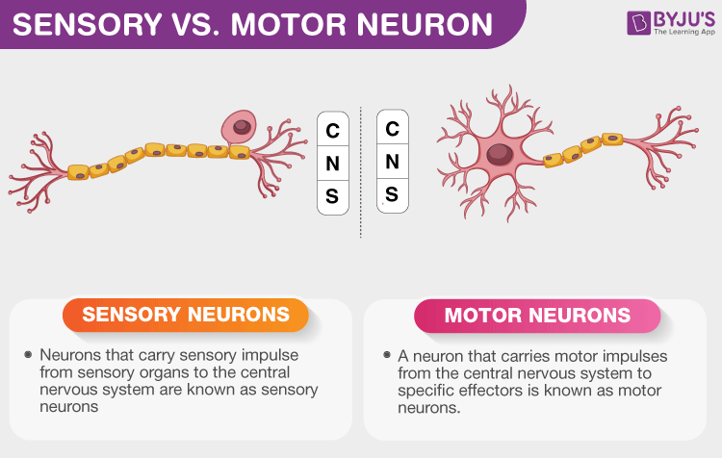
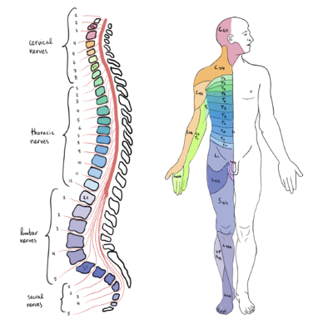
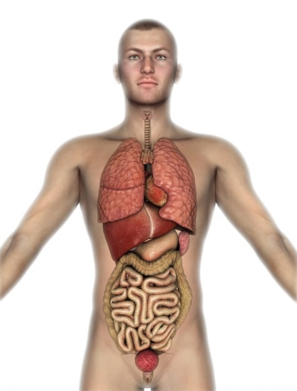
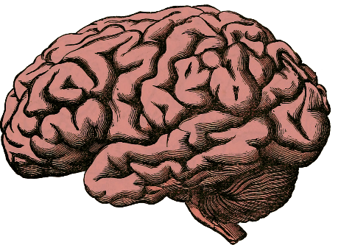
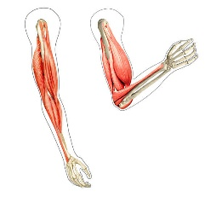
Anatomy
Nervous System
Peripheral Nervous System
Central Nervous System
Sensory neurons
Motor neurons
Brain
Spinal Cord
Somatic Nervous System
Autonomic Nervous System (ANS)
Sympathetic
Parasympathetic

Slide 19
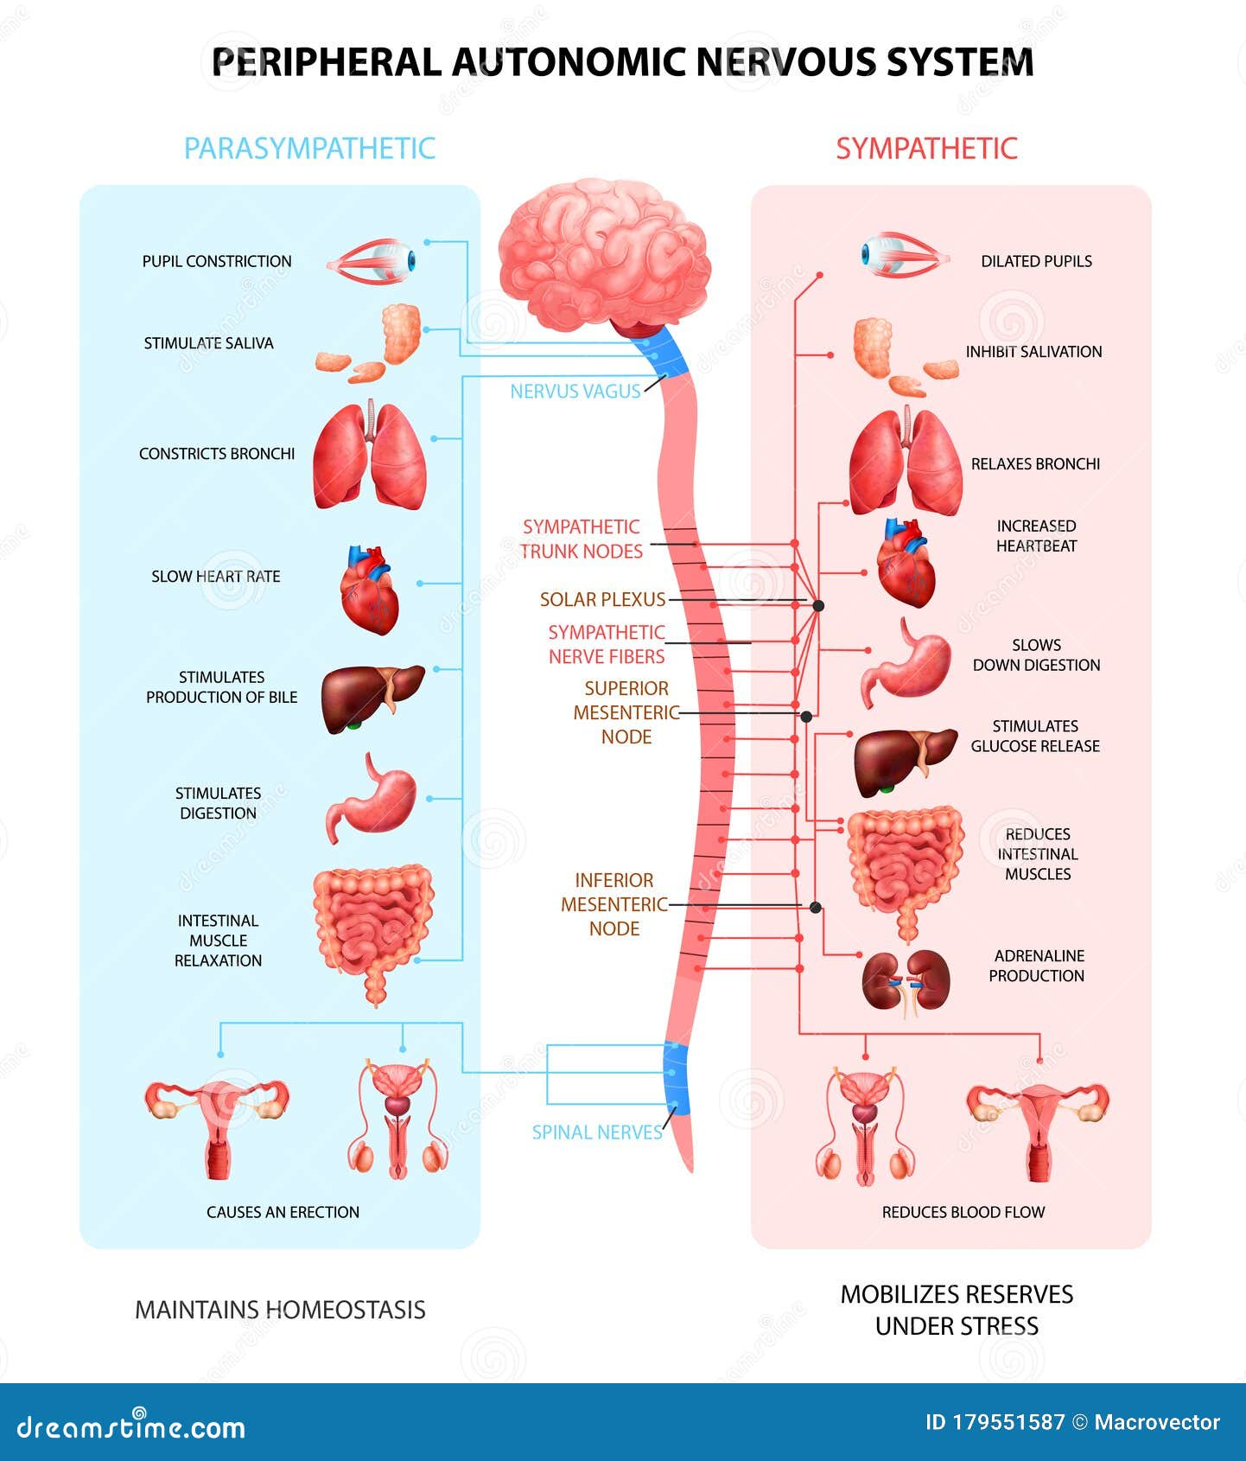
Autonomic Nervous System
The autonomic nervous system (ANS) controls autonomous body processes (blood pressure, breathing, digestion, heart beating, urination, …)
Sympathetic nervous system (SNS)
The Stimulator (accelerates heart rate, constricts blood vessels, and raises blood pressure)
Prepare the body for action (stressful or energetic activity)
Triggers a “sympathy” of the organs (concerted action)
Parasympathetic nervous system (PNS)
The Inhibitor (slows heart rate, increases intestinal activity, and other calming functions)
Dominates during rest state
Mediated (75%) by the vagus nerve
Enteric nervous system (ENS)
Governs the function of the gastrointestinal tract
Partly independent, but interacts with PNS and SNS
Nicknamed the “second brain”

Slide 20
Quizz
True / False?
The peripheral nervous system encompasses everything below the neck
The sympathetic nervous system was named because it expresses sympathy by calming the body
The vagus nerve is the most important nerve of the PNS
The SNS controls the heart rate, accelerating and decelerating it when required
When I’m dozing off after lunch, my parasympathetic system is predominant
Erectile dysfunction can sometimes be caused by a domination of the SNS
The gut is completely independent from the rest of the nervous system
Nervous System
Central Nervous System
?
Brain
?
Motor neurons
?
Somatic Nervous System
?
?
?

Slide 21

Thank you
Dominique Makowski
D.Makowski@sussex.ac.uk

